Slide 1
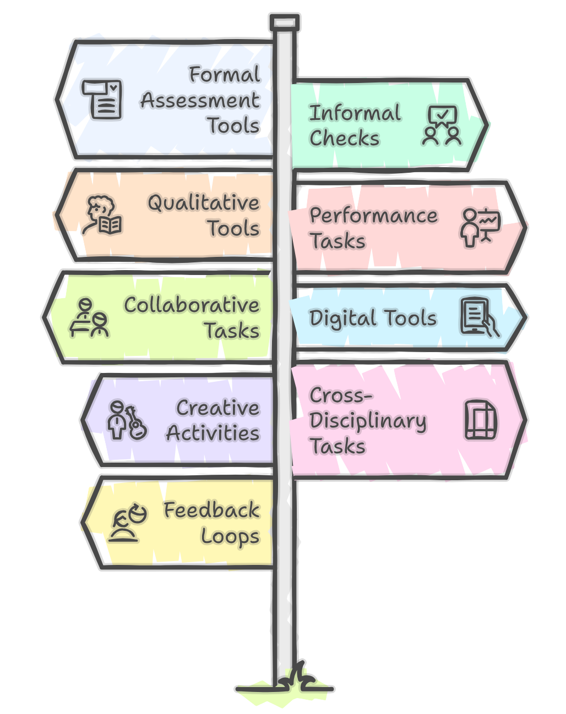

Assessment:
evidence gathering tools
Fabiana Farias, 2025
ffarias@uruguayeduca.edu.uy

Slide 2
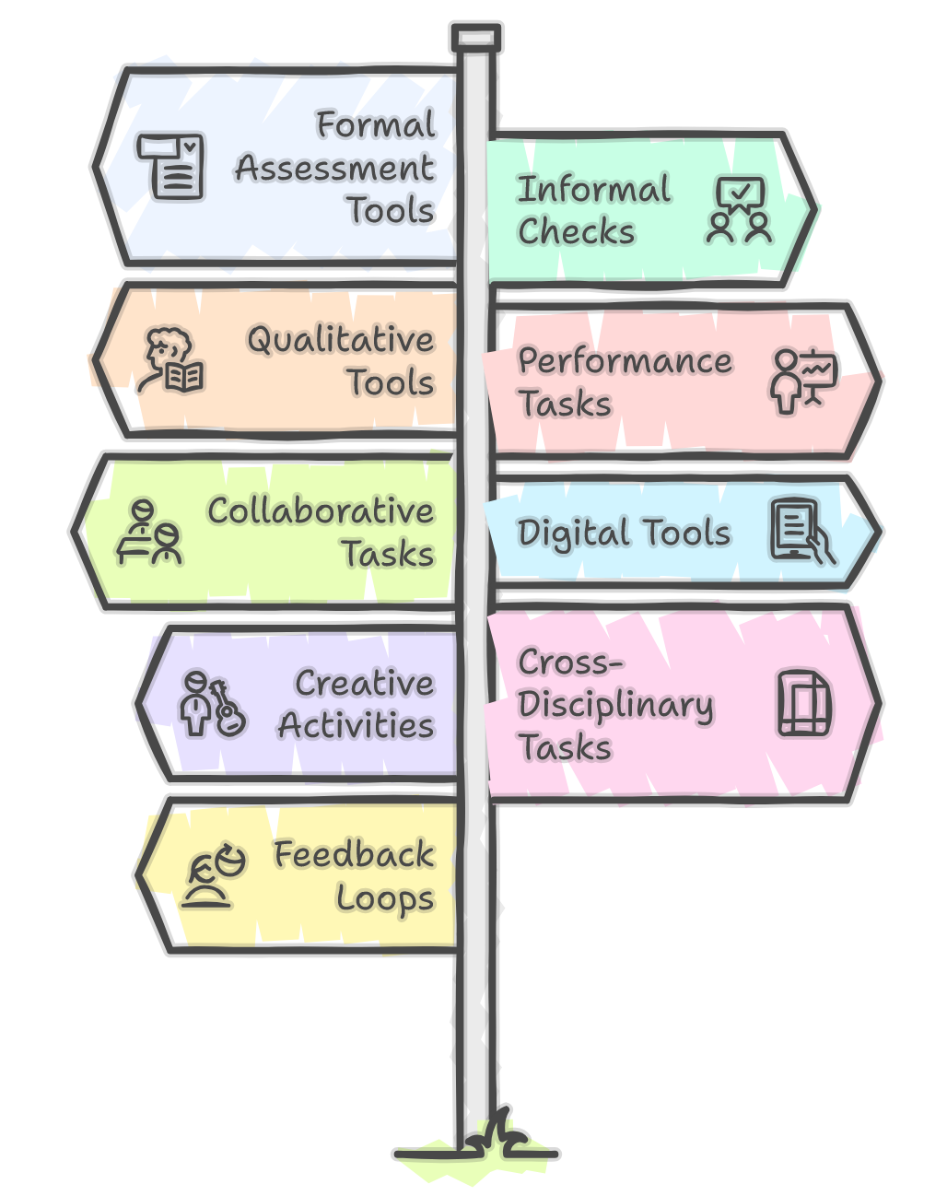
Dear all,
Here you will find a practical list of tools that will help you broaden your assessment toolkit. They come from various theoretical sources, but mainly from classroom observations. Every tool and technique has been implemented in Uruguay at one place or another, always with both great benefits and significant challenges.
I hope this document helps you support your students. I suggest using as many tools as possible, as long as students do not feel overwhelmed. The classification is only for clarity. It is somewhat artificial, but it intends to guide your decisions. As you will see, many tools could be placed in different groups, but a choice had to be made.
Please let me know if you find this useful, and do not hesitate to write to me if you have suggestions or questions.
Fabiana Farias
ffarias@uruguayeduca.edu.uy

Slide 3
Formal Assessment Tools
Formal tools are the traditional, structured ways of checking progress. They measure accuracy and are easy to grade, but they don’t always show creativity or learning strategies. In Uruguay, we usually combine them with other methods for a fuller picture.
Written Tests: grammar, vocabulary, or comprehension tests. They show what students remember/know at a fixed point in time.
Quizzes: quick and short checks of recent content, online (Kahoot, Quizizz, Google Forms) or paper-based.
Standardized Exams: Exams like KEY, Prelim, FCE, or TOEFL. They provide external benchmarks.
Rubrics: Grids with clear criteria. They make grading fair and transparent, and help students see what is expected.
Portfolios: Collections of work over time. They show growth, revision, and persistence.
Oral Exams: Structured interviews or presentations. They measure fluency, pronunciation, and interaction.
Diagnostic Tests: Given at the start of a course or unit. They show what students already know and where to begin.

Slide 4
Informal and Low stakes-checks
These are quick activities during class to see what students understand in the moment. They reduce pressure, so students are more relaxed and honest. They help teachers adjust instruction right away.
Exit Tickets: One-minute answers at the end of class. They may show what students understood or still doubt.
Think-Pair-Share: Students think, discuss in pairs, then share. It reduces anxiety and lets all students participate.
Class Polls: Quick votes, digital or hands-up. They give teachers a fast sense of group understanding.
Mini Whiteboards: Students write and hold up answers. This shows the whole class’s thinking at once.
Quick Writings: Short, unedited writing (3–5 minutes). It shows fluency and spontaneous language use.
Hot Seat Questions: Quick spontaneous oral questions to test recall. They must be supportive, not intimidating.
Observation Notes: Teacher logs of student behavior. Over time, they reveal participation and habits.
Learning Journals: Weekly notes by students. They write about their feelings, struggles, and successes.

Slide 5
Student centered Tools: students' voices
These tools highlight the learner’s voice and choices. They let students think about how they learn, not just what they produce. Teachers can model reflection at first so students learn to self-assess.
Self-Assessments: Students rate their skills with checklists or rubrics. This builds responsibility for learning.
Peer Assessments: Students give feedback to classmates. It develops judgment and collaboration.
Learning Stories: Students narrate how they worked on a task. This reveals effort and problem-solving.
Student Conferences: 1-on-1 teacher-student talks. They let students explain progress in their own words.
Metacognitive Journals: Students write about how they studied. This reveals strategies and autonomy.

Slide 6
Performance & Authentic Tasks
These tasks simulate real-life communication. They show if students can apply English in practical contexts. Teachers should provide clear scaffolding, so students succeed.
Presentations: Prepared talks to an audience. They teach vocabulary, organization, and confidence.
Role-Plays: Acting out real-life situations. They develop fluency and appropriateness in context.
Mini - Projects: Extended work like posters or podcasts. They may measure creativity and teamwork.
Creative Portfolios: Stories, essays, notes, emails, poems, or scripts. They show process, imagination and voice.
Debates: Formal arguments with rules. They measure reasoning and critical thinking.
Simulations: Mock real events. They mirror real life, requiring decisions, problem-solving, and multiple tasks.
Storytelling: Retelling or personal stories. They can emotionally connect students with their culture.
Service Learning: Projects in the community. They show English applied in real life.

Slide 7
Collaborative Evidence
These activities show what learners can do together. They build communication, accountability, and teamwork. Teachers should monitor groups to make sure every student participates.
Group Projects: Joint research, presentations or campaigns. Evidence comes from both process and product.
Shared Writing: Students co-write in a document. Teachers see how ideas develop together.
Peer Teaching: Students explain topics to peers. Teaching others shows real understanding.
Class Blogs/Wikis: Shared online spaces. They record collective learning.
Learning Partnerships: Pairs coach each other. This builds responsibility and peer support.

Slide 8
Digital Tools
Technology collects ongoing evidence of participation, progress, and effort. It can save time, but both teachers and students might be overwhelmed by too much data.
LMS: Platforms like CREA2 or Moodle. They track assignments and participation.
Analytics Dashboards: Show log-ins and task completion. They highlight patterns and trends.
Digital Quizzes & Games: Kahoot, Wayground, Wordwall. They engage students and give instant feedback/results.
Language Apps: Tools like Duolingo. They give extra practice and record effort.
E-Portfolios: Digital collections of work. They are long-term records of learning.
Recording Tools: Audio/video of student work. They let teachers and learners review progress.

Slide 9
Collaborative Evidence
These activities show what learners can do together. They build communication, accountability, and teamwork. Teachers should monitor groups to make sure every student participates.
Group Projects: Joint research, presentations or campaigns. Evidence comes from both process and product.
Shared Writing: Students co-write in a document. Teachers see how ideas develop together.
Peer Teaching: Students explain topics to peers. Teaching others shows real understanding.
Class Blogs/Wikis: Shared online spaces. They record collective learning.
Learning Partnerships: Pairs coach each other. This builds responsibility and peer support.

Slide 10
Arts & Creative-Based Evidence
Creative tasks allow students to show learning through art, music, or performance. They are great for engaging students who may struggle with tests.
Dramatizations: Plays or role-plays. They show pronunciation, expression, and creativity.
Song/Poetry Performances: Live or recorded. They highlight rhythm and memory.
Visual Storyboards: Sequences of images. They show comprehension and narrative skills.
Infographics/Posters: Visuals with text. They synthesize ideas clearly.
Digital Storytelling: Using Canva, Animaker or Powtoon. They combine writing, images, and audio.
Photo Journals: Captioned photos. They link daily life with English practice.

Slide 11
Cross-Disciplinary Evidence
These tasks integrate English with other areas. Teachers can start small by coordinating with one colleague.
Project based learning and Problem-Based learning: Solving real issues in English using knowledge from many areas. They test creativity and language together.
Interdisciplinary Projects: English with science, history, or art,for example. They create richer outcomes and challenge students’ skills.
Pecha Kucha: Fast, timed presentations. They build conciseness and clarity.
Debates and discussions: speaking enhancers. They encourage learners to think critically and listen carefully to others.

Slide 12
Feedback and Dialogic Evidence
Evidence can also come from conversations. Feedback is more powerful when it is specific, kind, and actionable. Teachers should encourage students to also give feedback to each other. The value lies not only in what students say, but also in how they justify, question, and respond to others.
Teacher-Student Conferences: Short interviews. They reveal progress and needs directly.
Peer Feedback Circles: Group feedback sessions. They develop critical listening and revision.
Whole-Class Reflections: Group discussions. They build collective awareness of learning.
Learning Contracts: Agreements on goals. They give students ownership and responsibility.

